Slide 1

Carthago Display
Sprint Review #1

Slide 2
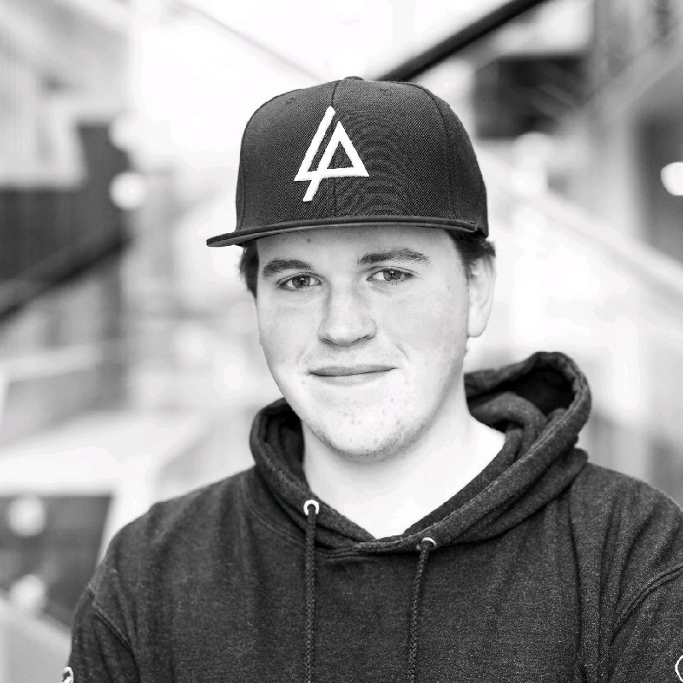
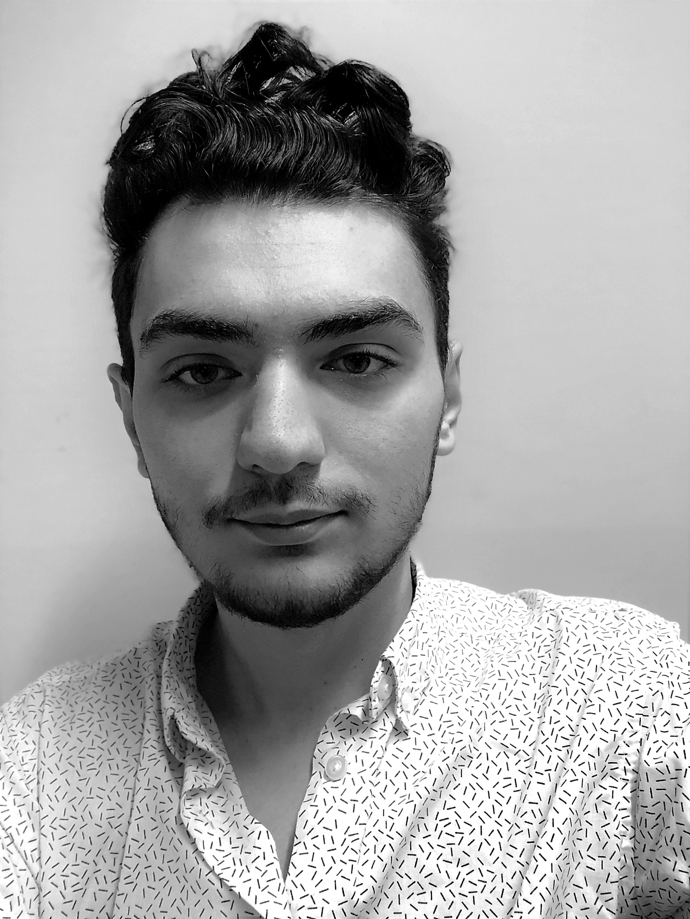
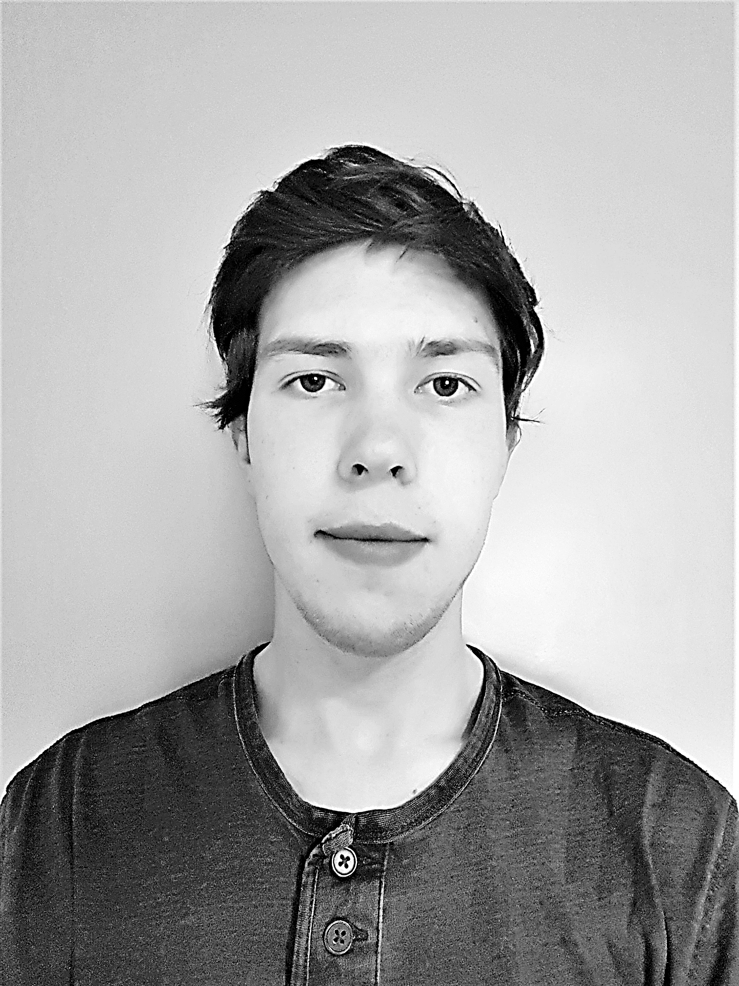
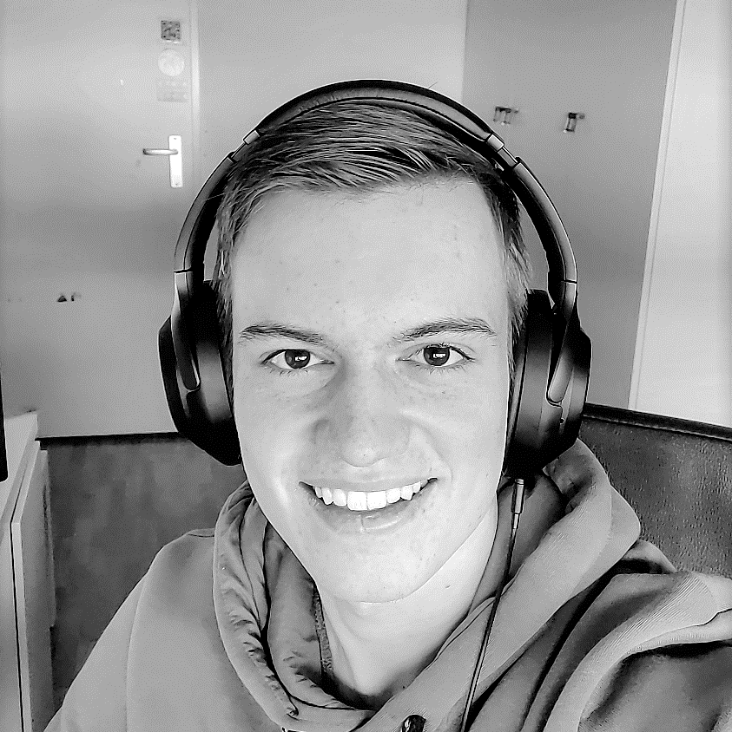
Team: EH12V.Sb #2
Syon Foppen
Full stack developer
Erel Cetin
Front end developer
Emanuel de Jong
Back-end developer
SCRUM MASTER
Kali van den Heuvel
Full stack developer

Slide 3

Inleiding
User Stories
Burn down chart
Functionaliteiten
Framework
Demo
Vragen

Slide 4
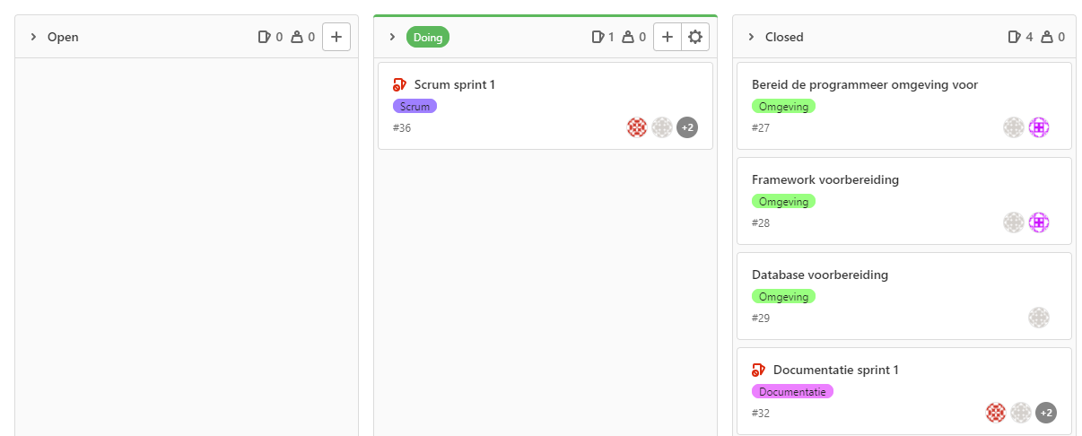
User Stories: Sprint #1

Slide 5
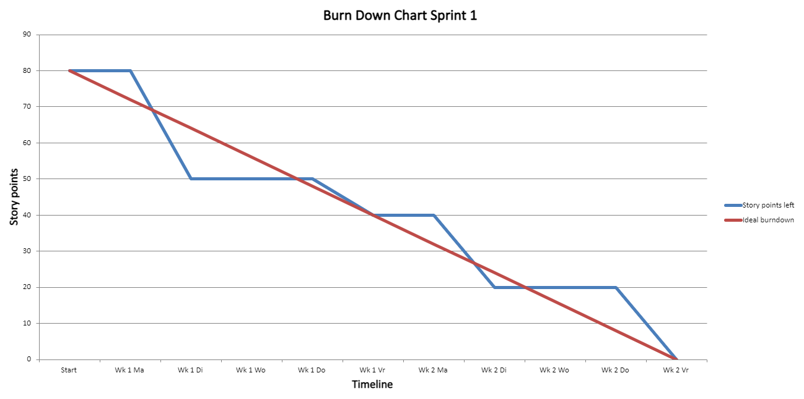
Burn Down Chart: Sprint #1

Slide 6

Functionaliteiten
CMS
Spotify Playlist
RSS Feeds
Nieuwe Medewerkers
Outlook API

Slide 7

Framework: Blazor
ASP.NET Core
Live Datastream
Frontend Components
C# in zo wel Front- als backend
Security
Docker

Slide 8
DEMO

Slide 9


Vragen?

